Slide 2
Hello!
How are you?

Slide 3
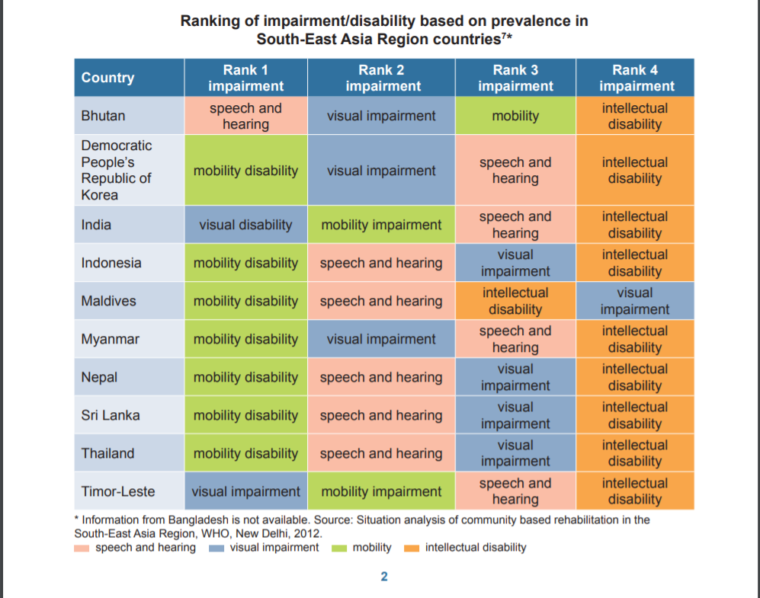
Problem Background - South-East Asia Region

Slide 4
The Deaf and Mute – Facts and Figures
According to the World Health Organization (WHO), 466 million people across the world have disabling hearing loss (over 5% of the world’s population), of whom 34 million are children. Statistics released by the United Nations also indicate that, in Egypt alone, 7.5 million people suffer from deafness or hearing impairment.
Studies expect these numbers to rise to 900 million by 2050.

Slide 5
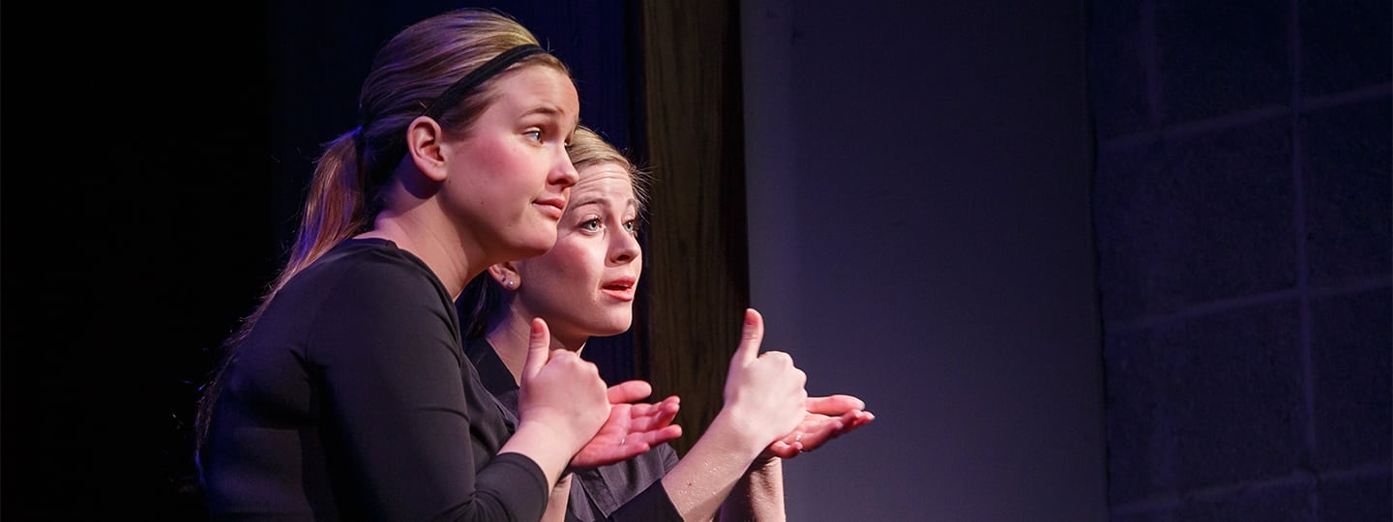
How do they communicate?

Slide 6
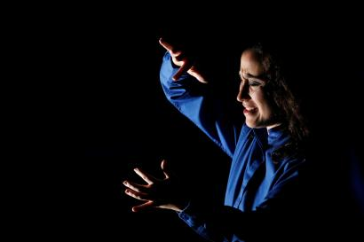
Problems they face
Isolation
Criticism
Projecting their ideas
Notes:
Ramith put the child’s picture

Slide 7
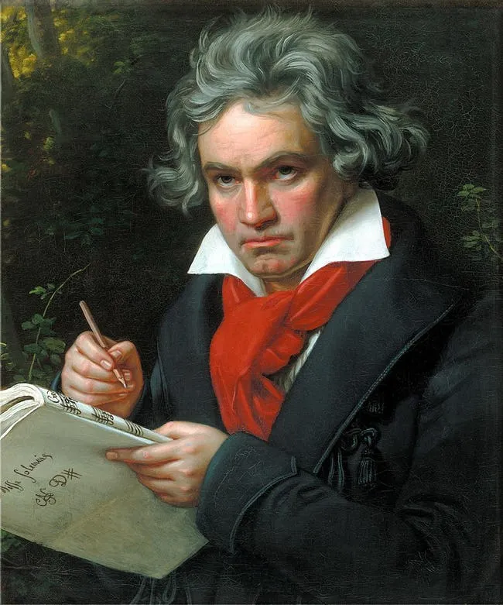
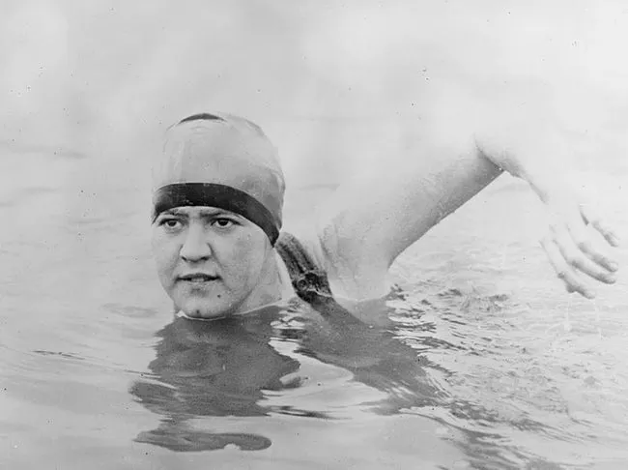
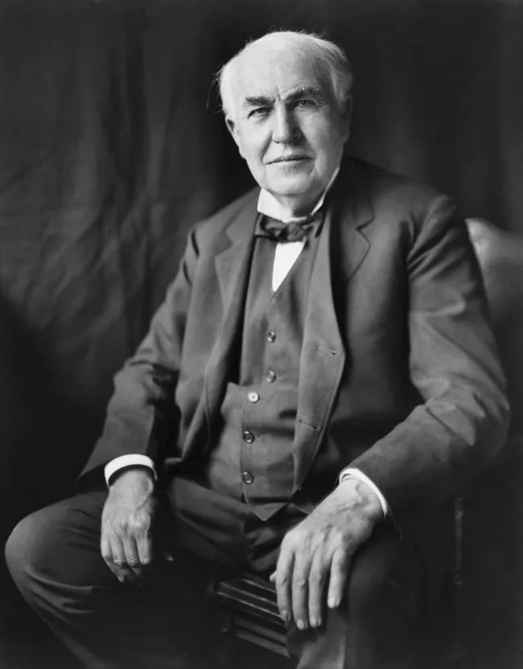
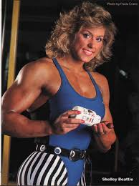
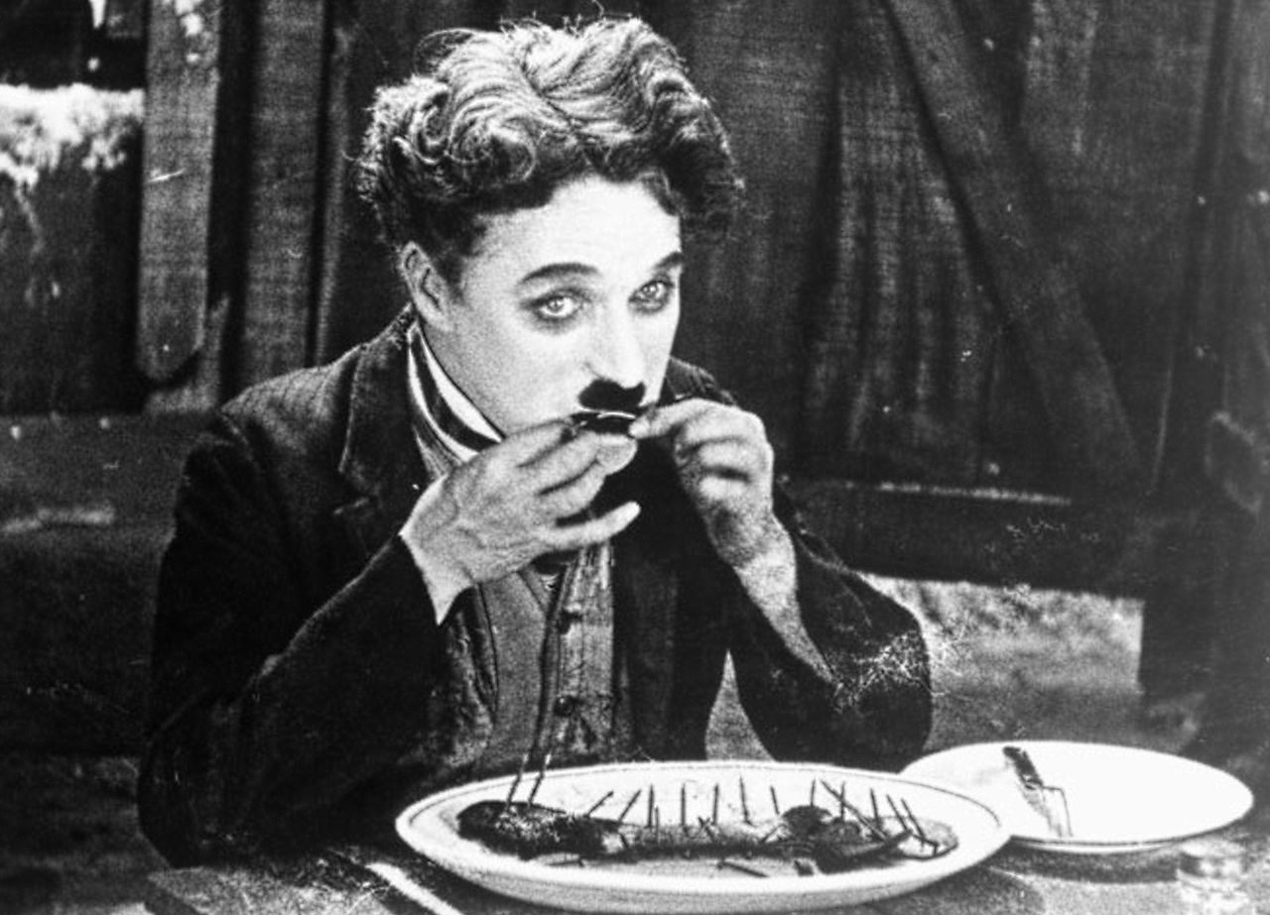
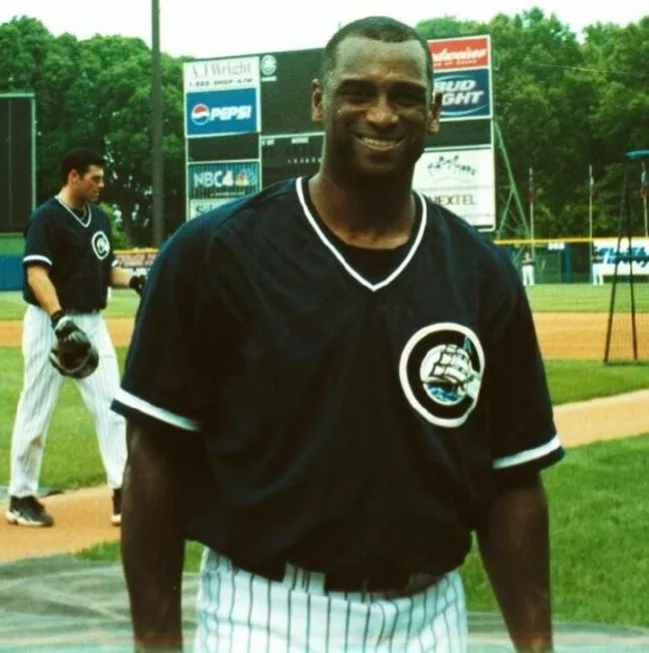

Slide 8

Will the situation be the same in another 50 years?

Slide 9

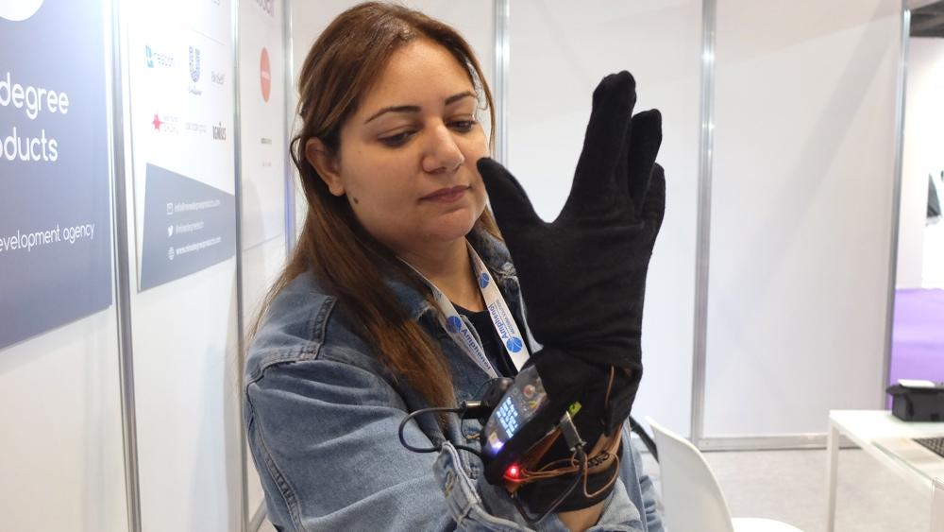
Existing Solutions:
Using video cameras and image processing.
Eg: KinTrans
Text-speech convertors.
Gesture sensing glove based solution

Slide 10
Electromyography Based Sign Language Classification

Slide 11
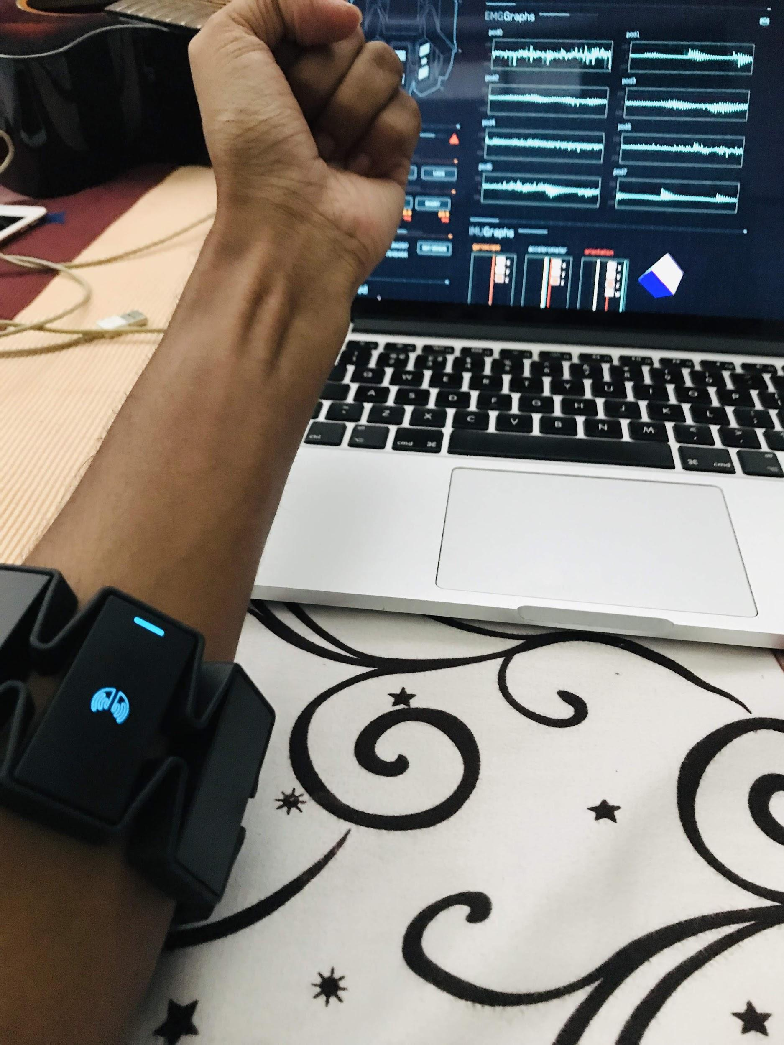
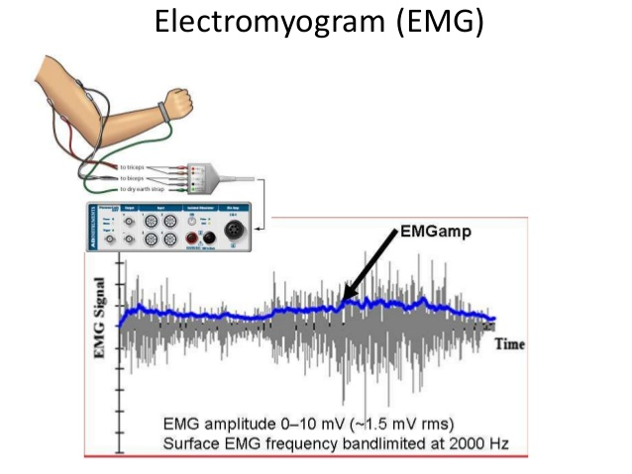
What is EMG ?
The detection, amplification and recording of changes in skin voltage produced by underlying skeletal muscle contraction is called Electromyography.

Slide 12
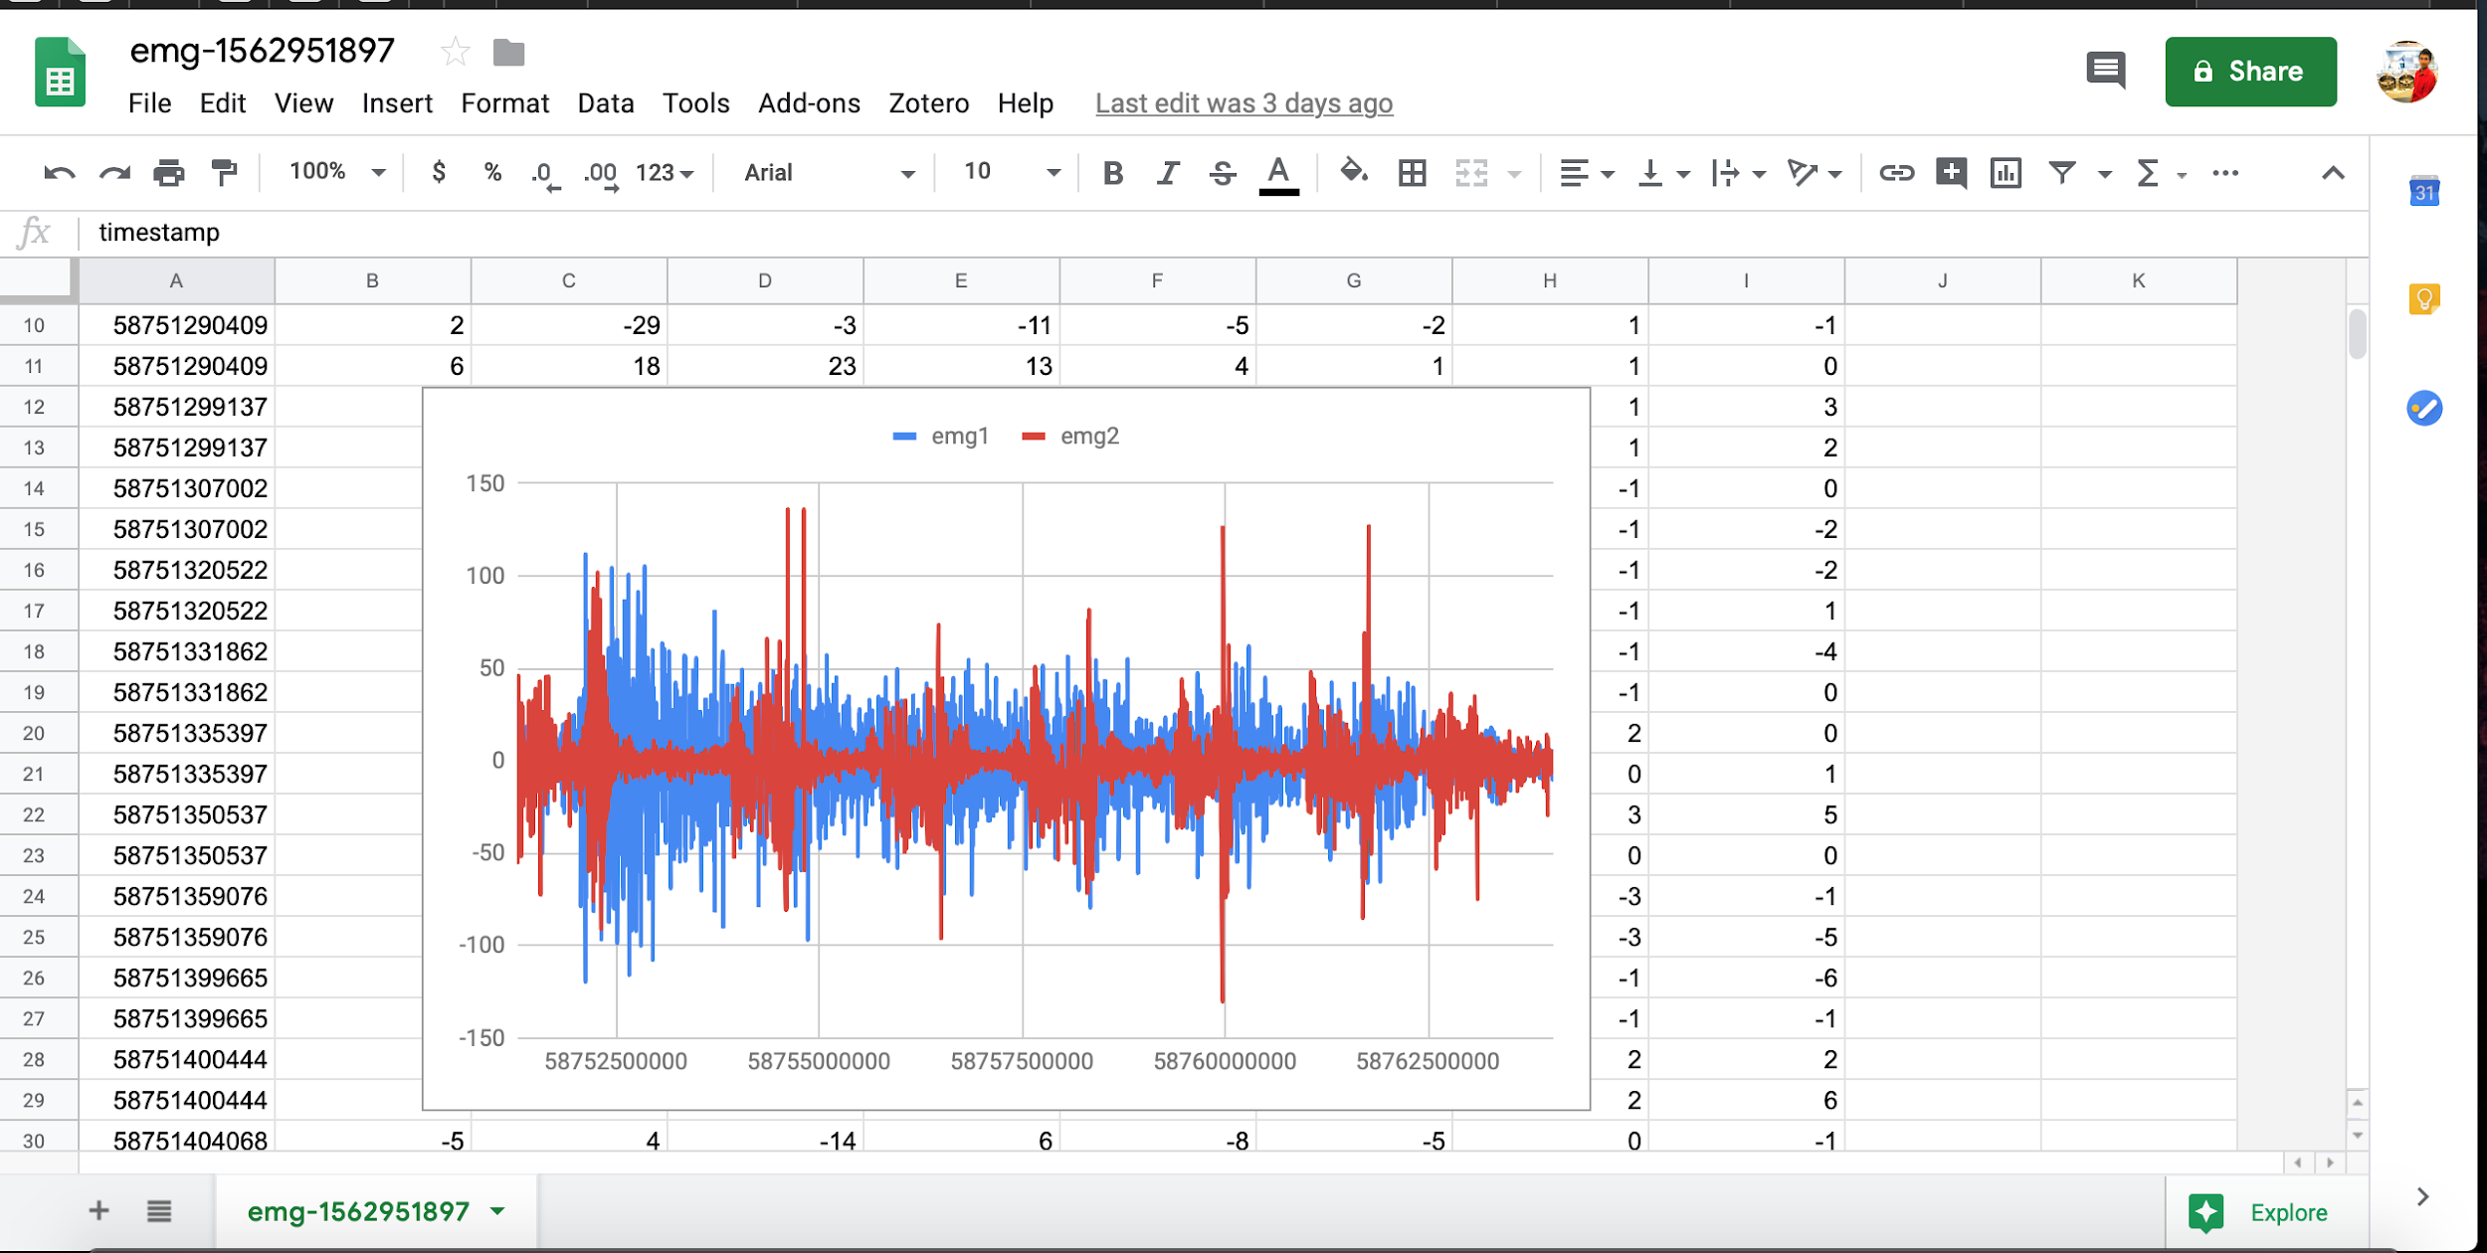

Slide 13
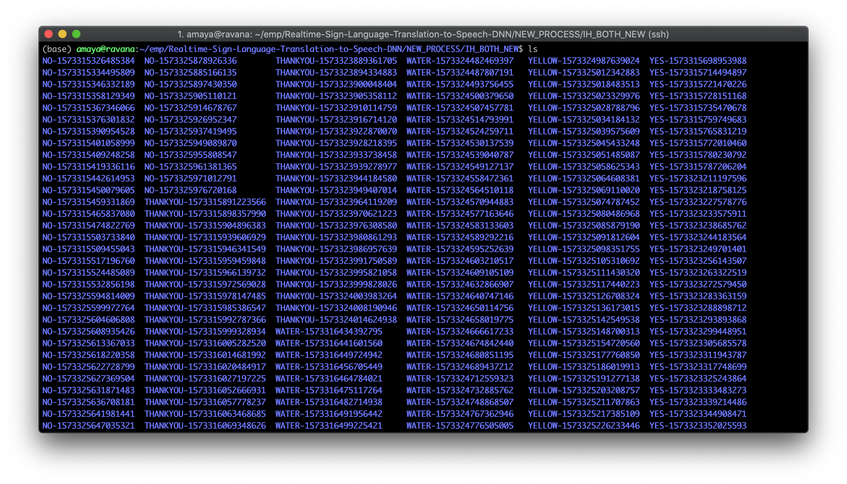
Dataset

Slide 14
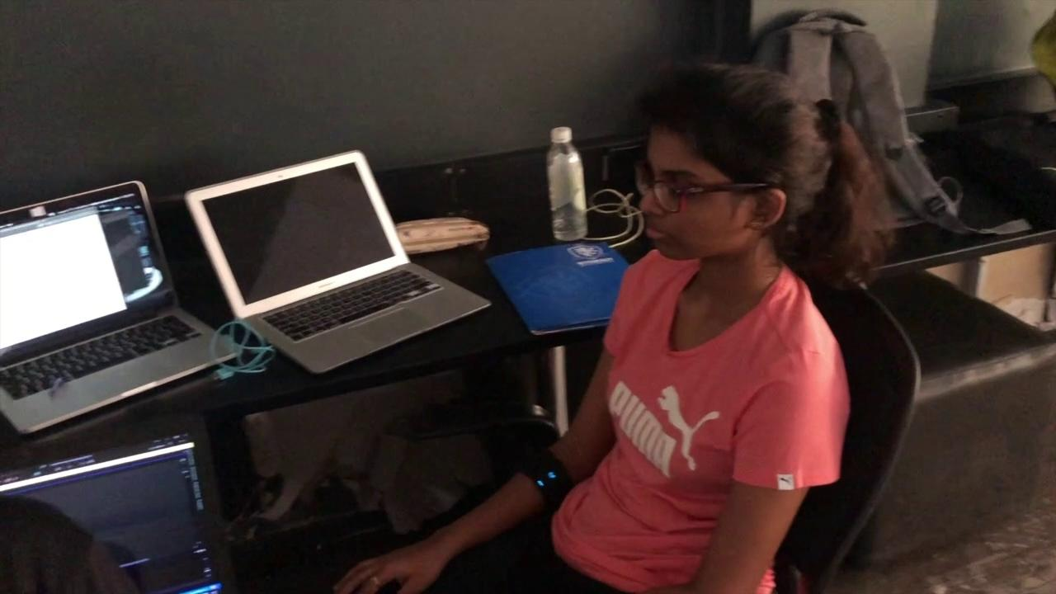

Slide 15
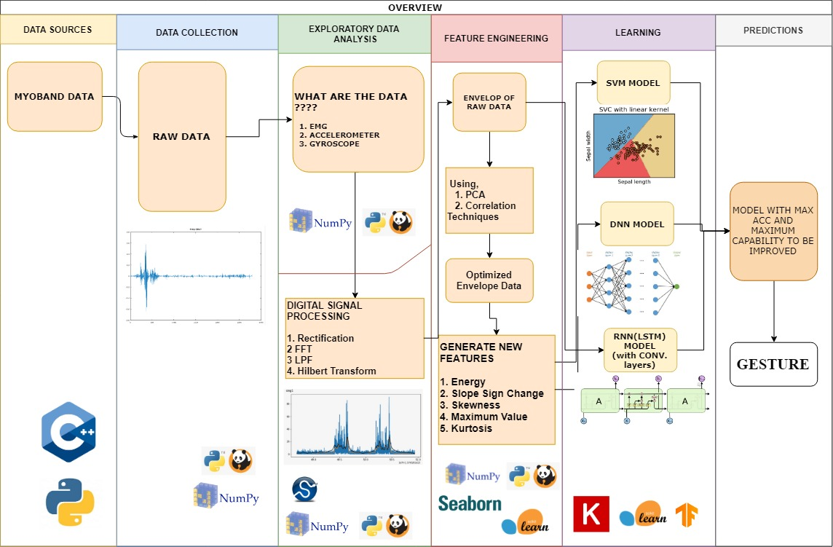

Slide 16
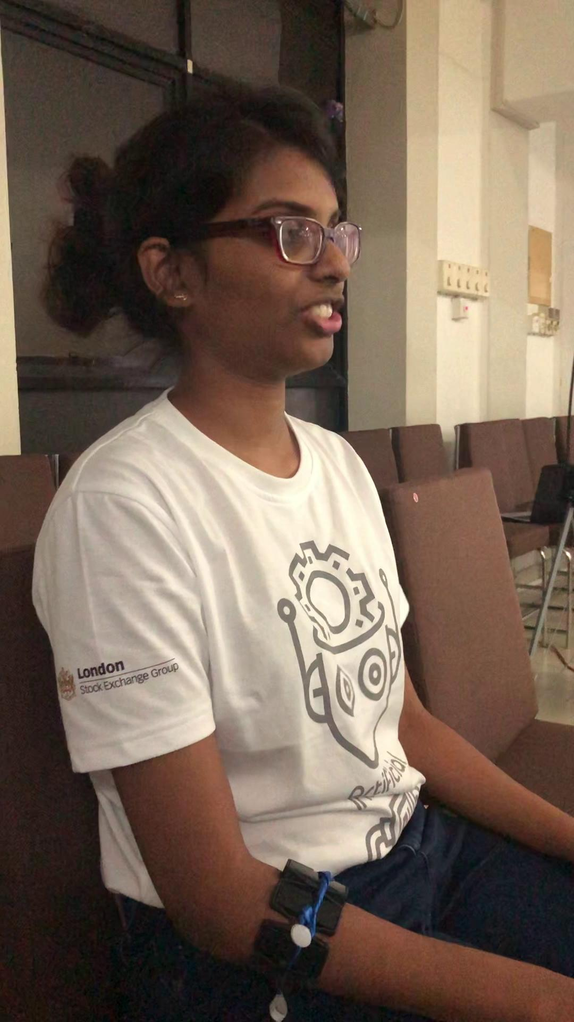
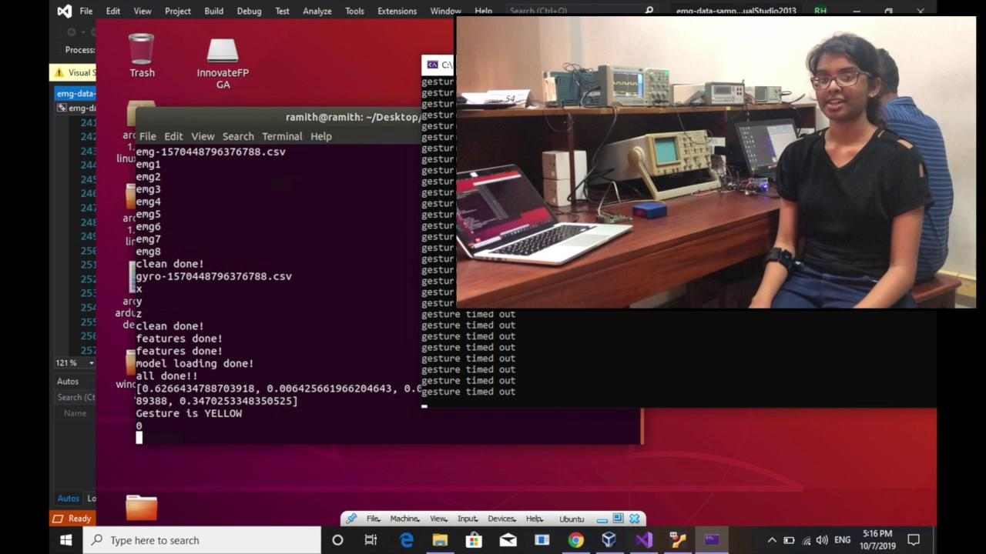
Demo
Notes:
DATA COLLECTION AND PREPROCESSING - RAMITH

Slide 17
FUTURE ...
Construct grammatical sentences in real time using NLP from the predicted word sequences.
Create cloud interface to store the user data to train the already trained model in order to improve the performance of the model - collaborative development
Create a custom user-interface
Develop an affordable custom hardware affordable using this technology.

Slide 18
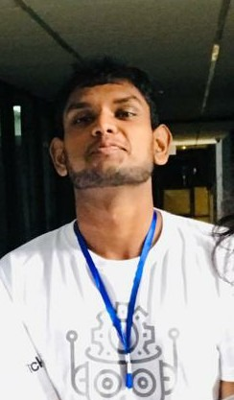



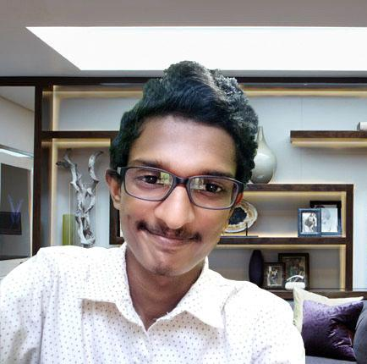
Our Team
Second year Undergraduates of Electronic and Telecommunication Engineering & Biomedical Engineering University of Moratuwa
Kithmini
Herath
Udith Haputhanthri
Ramith Hettiarachchi
Hasindu
Kariyawasam
Mohommed
Afham

Slide 19

Thank You!
Visit our github page for project updates

Slide 20
Questions?

Slide 21
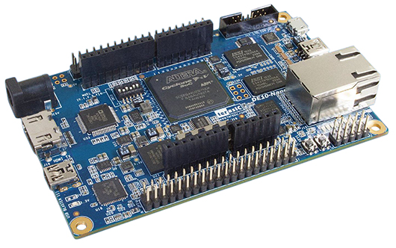
Which Hardware platform are you using?
Powerful sensor fusion of (IMU and EMG) of 2x MYO armbands
Ability to convert gestures to text (OLED).
Convert sign language gestures to speech.
Text to speech language can be customized.
Sending a stream of text to a remote computer.
Sending Urgent/Emergency commands.
Filter out general hand movements from sign commands

Slide 22
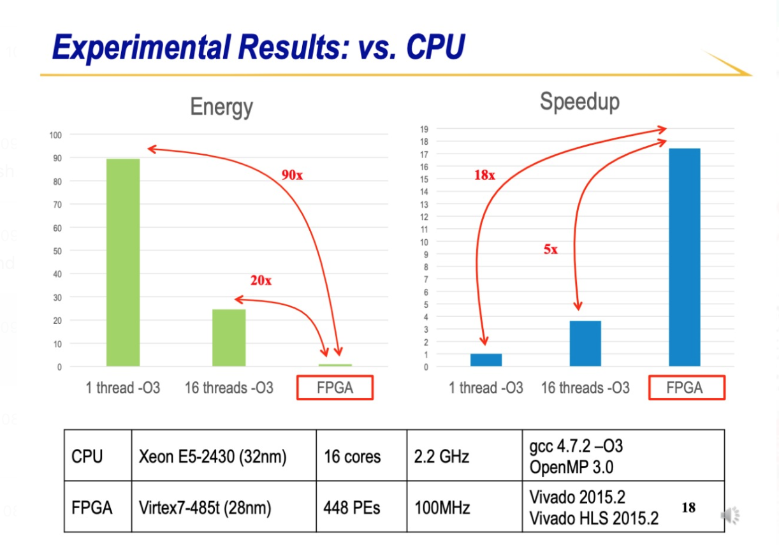

Slide 23
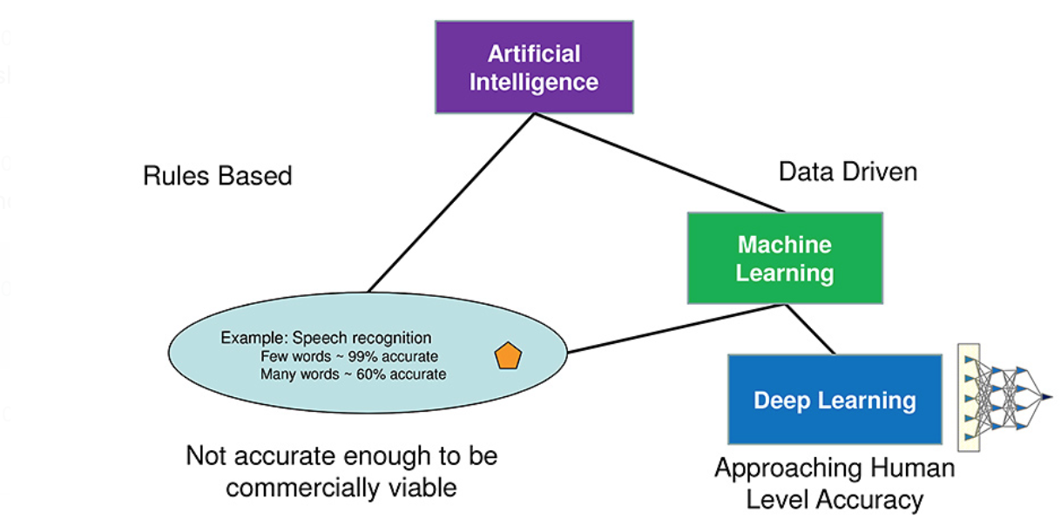
Why Neural Network?

Slide 24
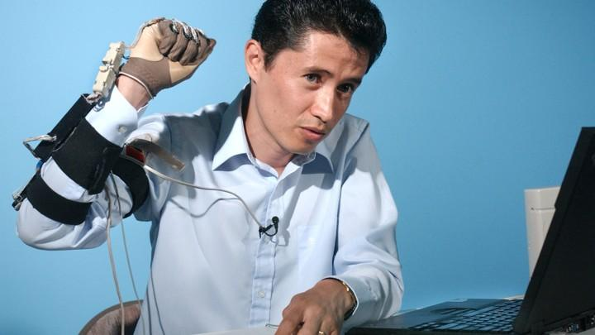
Why gloves doesn’t work?
Practicality
Seems unnatural

Slide 25
COST ?

